Slide 1
Tech Interview Prep:
Solving the “Lost in the Middle” Phenomenon & Advanced Re-Ranking in High-Stakes RAG
“Walk me through how you solve the ‘Lost in the Middle’ problem and how re-ranking improves retrieval precision in high-stakes domain applications.”
Problems:
1) The search finds related but wrong information
2) The AI forgets information placed in the middle of a long prompt
Name: Dara Sen
Class: AD331 (Artificial Intelligence)

Slide 2
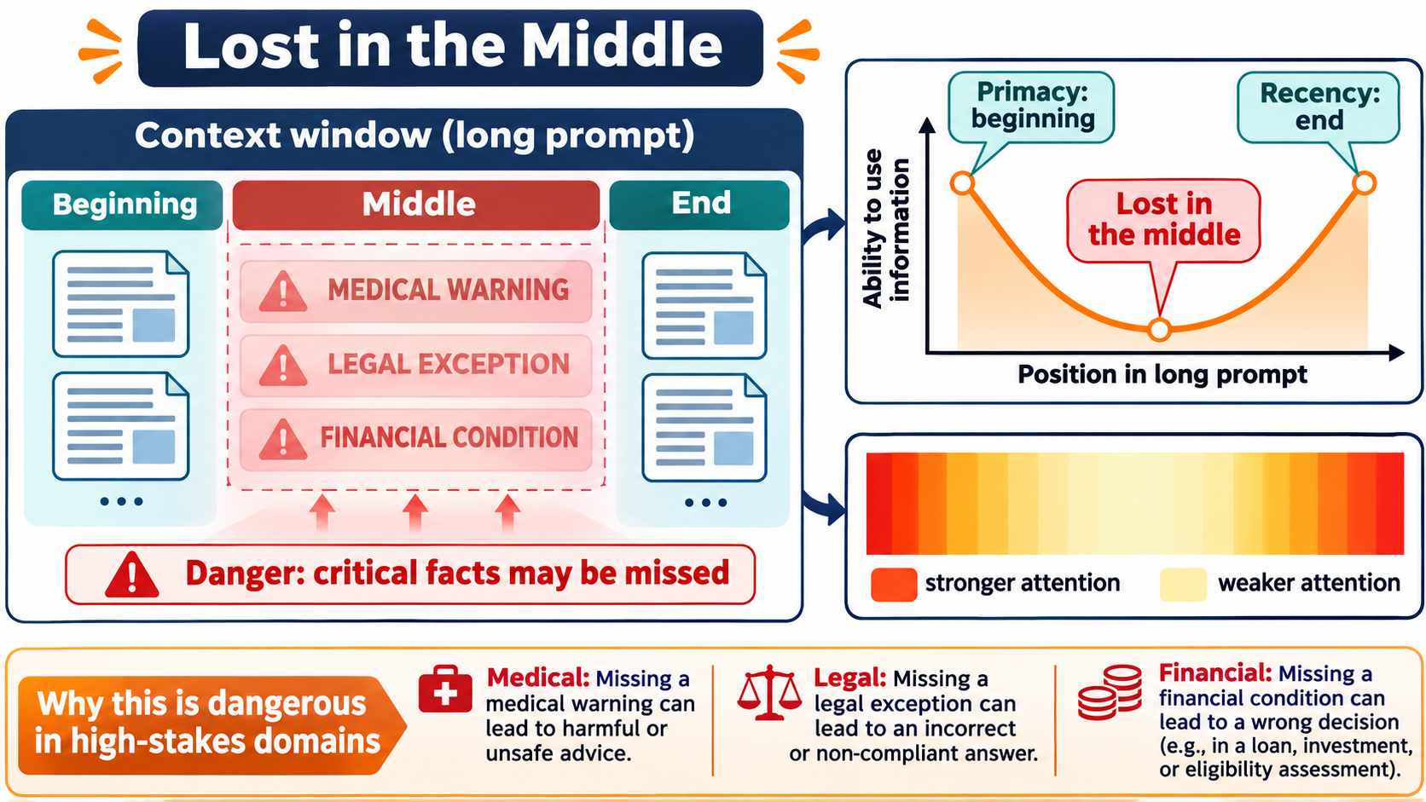
Deconstructing “Lost in the Middle”: Attention Mechanics

Slide 3
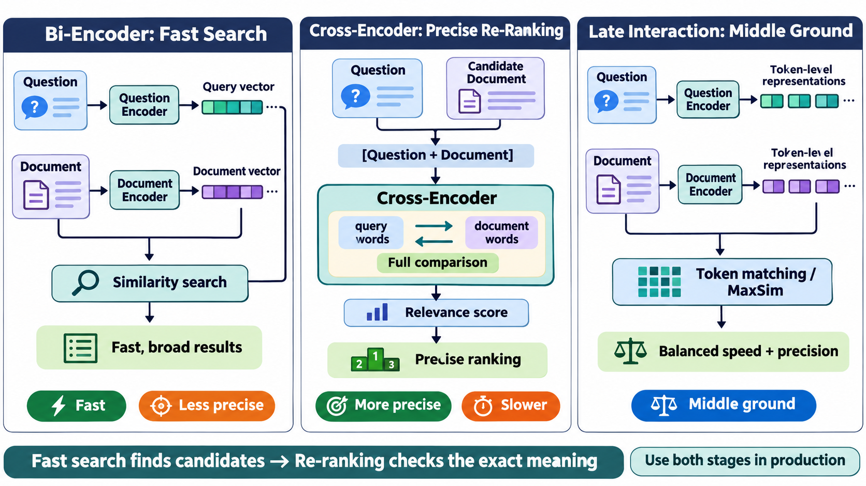
Two-Stage Retrieval: Bi-Encoders vs. Cross-Encoders

Slide 4
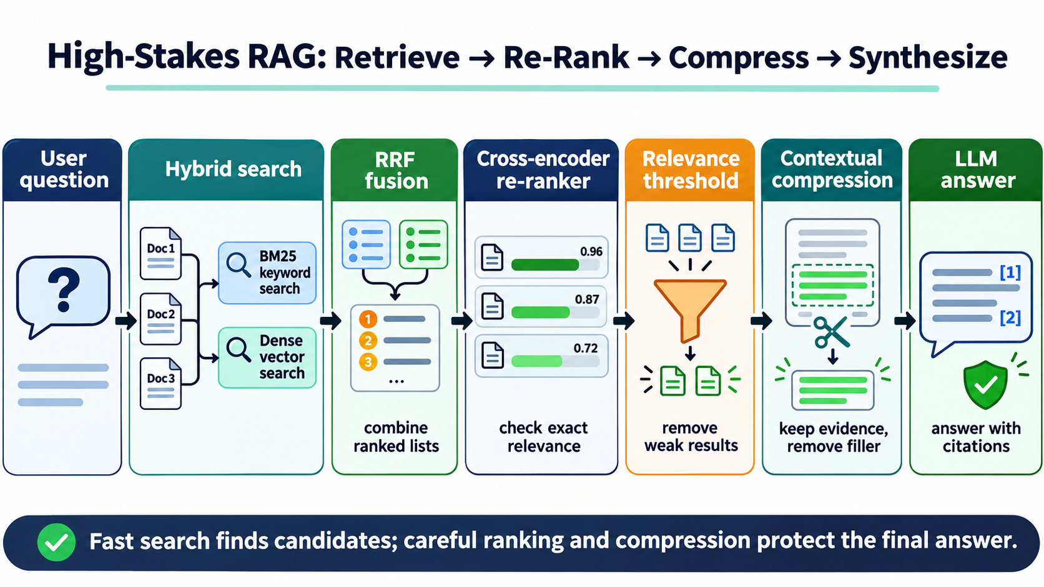
Production Pipeline for High-Stakes Domains

Slide 5
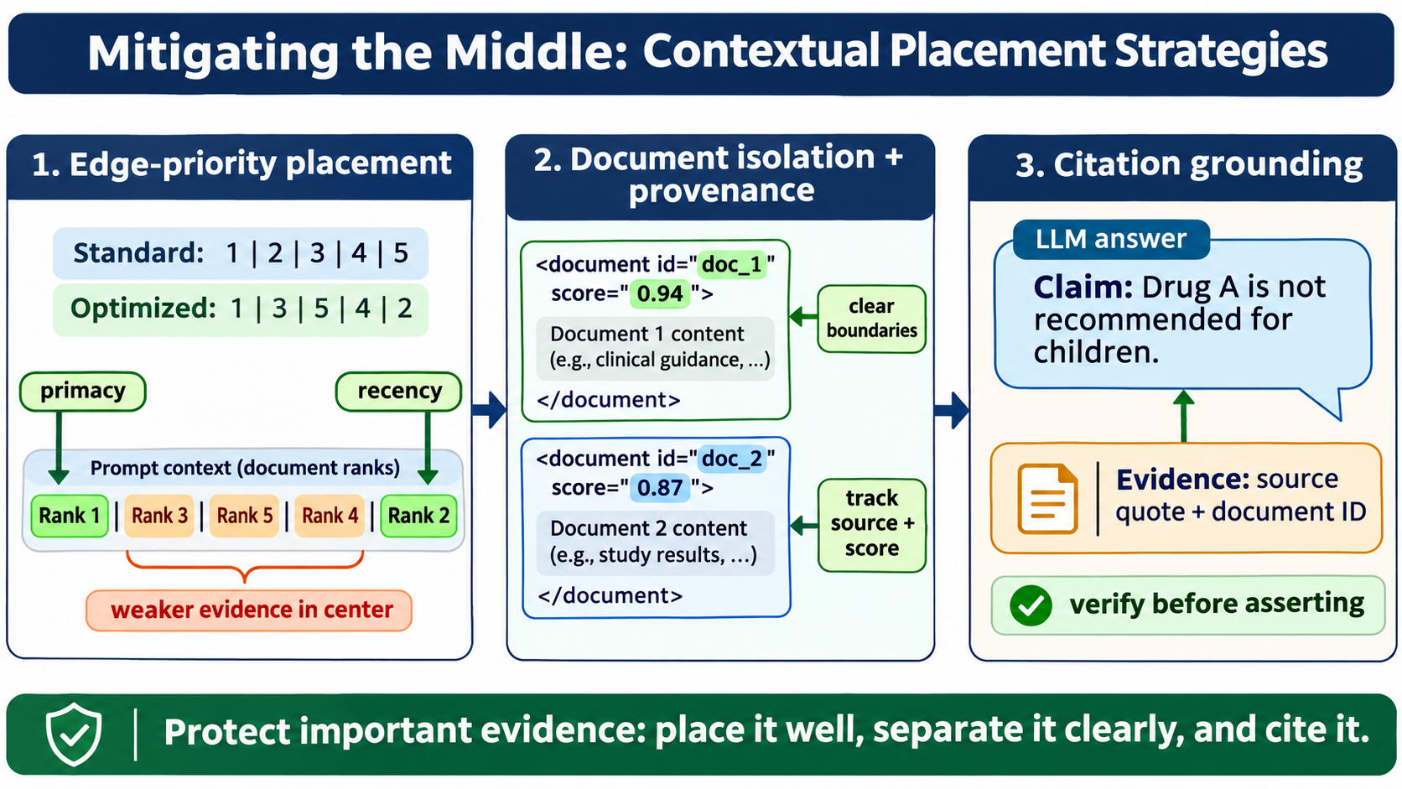
Mitigating the Middle: Contextual Placement Strategies

Slide 6
Summary & Enterprise Systems Takeaways
Bi-encoder vs. Cross-encoder (Late interaction: keeping all token vectors)
Lost in the Middle --> Edge-priority placement
Citation grounding

